Slide 1
Creating the Server-Side Scripts II
Week 06.

Slide 2
Objectives
Demonstrate how to connect to database server using Node.js;
Demonstrate how to execute SQL commands in Node.js;
Demonstrate how to create Web API;
Demonstrate how to route HTTP requests in Node.js.

Slide 3
Tools Required
XAMPP – MySQL
MySQL Workbench
Visual Studio Code
Chrome Browser
Postman

Slide 4
Creating The Comment Class

Slide 5
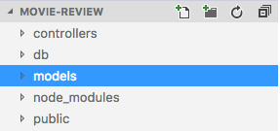
Creating the Comment Class
You will now learn to write the SQL codes in JavaScript to create a Comment class.
Under the root folder of movie-review project, create a new folder called models.
Under the models folder, create a new file called Comment.js.
Watch week 6.2 demo here

Slide 6
Creating the Comment Class
Add the following codes to create the constructor of the Comment class
"use strict";
class Comment {
constructor(id, movieId, movie, review, username, rating, datePosted) {
this.id = id;
this.movieId = movieId;
this.movie = movie;
this.review = review;
this.username = username;
this.rating = rating;
this.datePosted = datePosted;
}
//add the set and get methods here }
module.exports = Comment;

Slide 7
Creating the Comment Class
Add the following get methods below the constructor
getId() {
return this.id;
}
getMovieId() {
return this.movieId;
}
getMovie() {
return this.movie;
}
getReview() {
return this.review;
}
getUsername() {
return this.username;
}
getRating() {
return this.rating;
}
getDatePosted() {
return this.datePosted;
}

Slide 8
Creating the Comment Class
Add the following set methods below the constructor
setMovieId(movieId) {
this.movieId = movieId;
}
setMovie(movie) {
this.movie = movie;
}
setReview(review) {
this.review = review;
}
setUsername(username) {
this.username = username;
}
setRating(rating) {
this.rating = rating;
}
setDatePosted(datePosted) {
this.datePosted = datePosted;
}

Slide 9
Creating The Comment DB

Slide 10
Creating a CommentsDB.js
You will now learn to write the SQL codes in JavaScript to access the database.
Under the root folder of movie-review project, create a new folder called models.
Under the models folder, create a new file called CommentsDB.js.

Slide 11
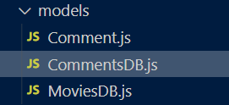
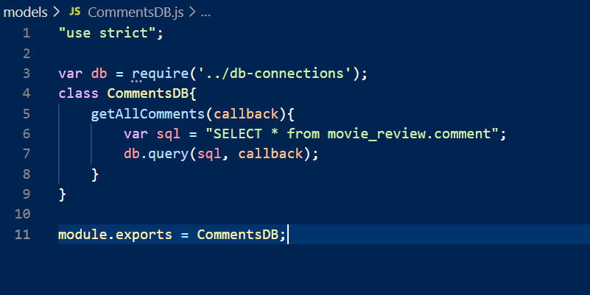
Creating the CommentsDB.js
In the CommentsDB.js file, add the following codes shown below.

Slide 12
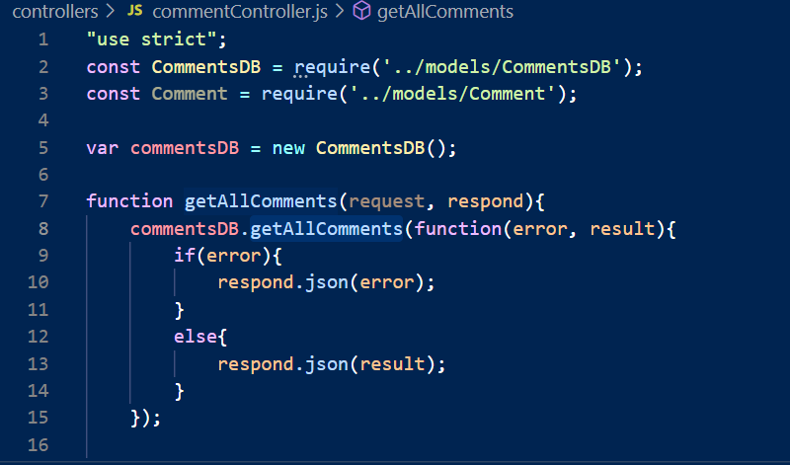

Creating the commentsController.js
In the commentController.js file, add the following codes shown below

Slide 13
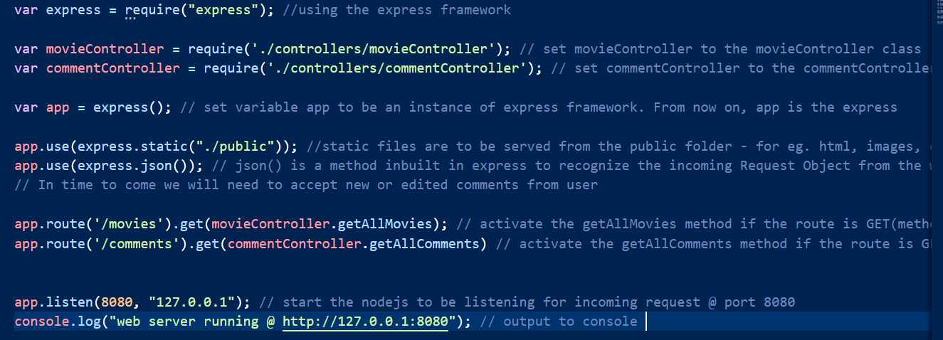
Updating the server.js
Next, open your server.js file to edit.
Add the highlighted codes as shown here.

Slide 14
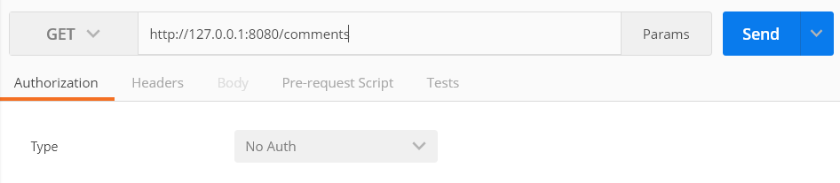
Test it!
Launch the Postman app in your browser
Select the “GET” function and paste the URL http://127.0.0.1:8080/comments to test if the API that we have created to retrieve movies is working correctly (remember to start your SQL server in XAMPP)
Click on the “Send” button

Slide 15
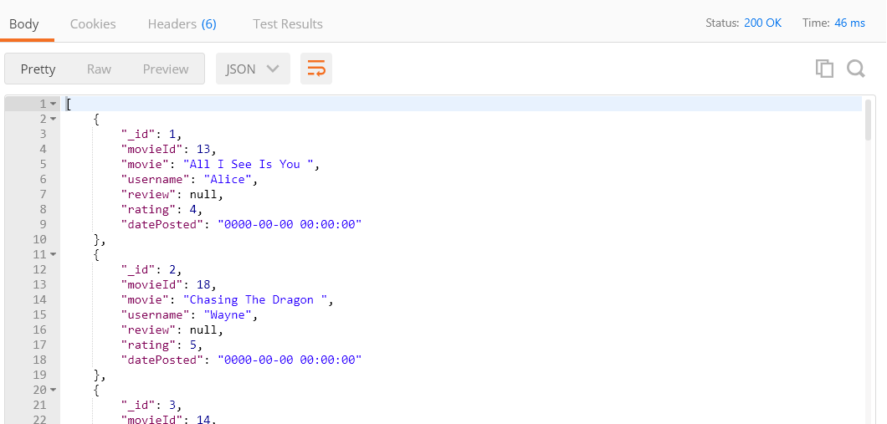
Test it!
You should see the following data in JSON format in the “Body” of the Postman app
When the retrieval of data is successful, you should see a status “200”

Slide 16
Next Episode
In the next episode, you will learn how to create APIs to add, update and delete comment.

Slide 17
Reference
TutorialsPoint – Learn MySQL
https://www.tutorialspoint.com/mysql/index.htm
W3Schools – Node.js MySQL Select From
https://www.w3schools.com/nodejs/nodejs_mysql_select.asp
expressJS – Get URL and POST Parameters
https://scotch.io/tutorials/use-expressjs-to-get-url-and-post-parameters
TutorialsPoint – Request Object
https://www.tutorialspoint.com/nodejs/nodejs_request_object.htm
expressJS Documentation
http://expressjs.com/en/api.html

Slide 18
The End

